Slide 1
Prostate
Cancer
Alisa Tvorun Dunn, Ayush Chakraborty, Afsha Tabasum,
Parinitha Kompala, and Jessica Serrao
Notes:
AFSHA

Slide 2

Introduction
May 2015
June 2015
June 2016
OUR GOAL
Programs & Data
Metastatic castration resistant prostate cancer (mCRPC)
Groundwork for National Cancer Institute’s Genomic Data Commons
GDC had analyzed nearly 50,000 raw data sequences
map/transform raw data to optimize downstream analysis of the prostate cancer cohorts
Excel, SQL and R to analyze 3 datasets
Notes:
JESS
The 2015 paper was a multi-institutional study that aimed to investigate a form of metastatic prostate cancer (MCRPC)
Resistance in males to androgen deprivation therapies
purpose : facilitate precision medicine thru exome and transcriptome sequencing of tumor biopsies
WE FOUND INTERESTING: at this time prospective cohort tumor studies with sufficient tumor content
Genomic Data commons (GDC) aggregates data from several genome research programs like TCGA and OCG
Standardize data processing by using common bioinformatics pipelines to reduce batch effects

Slide 3
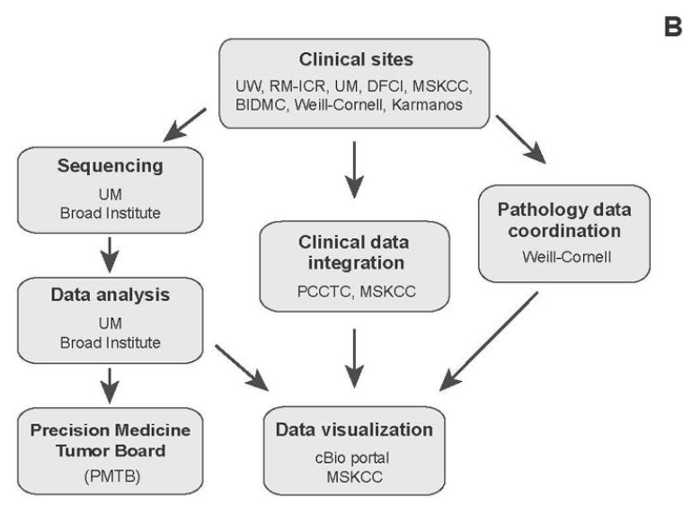
Data Description #1: mCRPC
 | Description
Patient ID | unique patient identifier (number)
Sample ID | unique biopsy sample identifier from clinical trial(number)
Mutation Count | mutation rate for mCRPC defined as mutations per megabase or mutations/Mb (number)
Fraction Genome Altered | fraction of mutant allele variants in biopsy (number)
Diagnosis Age | patient's age when they were diagnosed (number)
Tumor Site | physical site of tumor on human body from which biopsy was taken (string)
ABI & ENZA Exposure Status | exposure to second-generation androgen deprivation therapies (binary: yes/no)
Center of Sequencing | the international academic medical center where exome sequencing occurred (string)
Prior Treatment | receipt of previous androgen deprivation therapy (binary:yes/no)
Site Sequenced | site of exome sequencing: Broad or UM (string)
Tumor Content | percentage of tumor captured in the biopsy (number)
Notes:
JESS
-extracted from the cBioportal a public cancer genomics site hosted by the Memorial Sloan Kettering Cancer Center
150 individuals with 17 data points

Slide 4
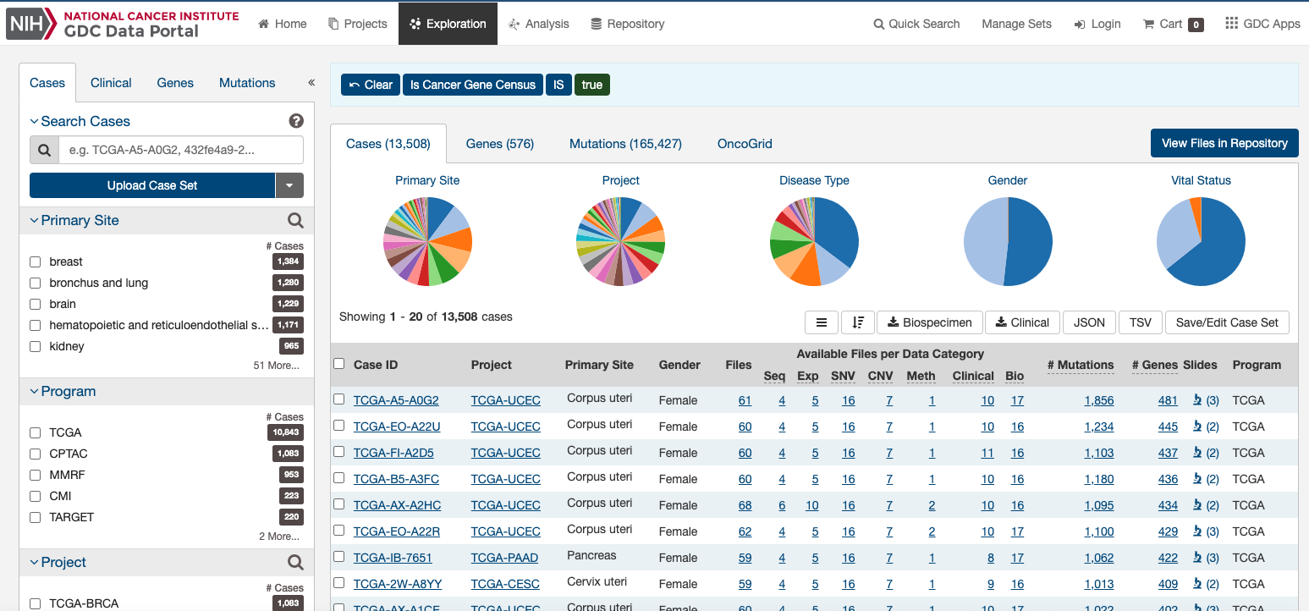
Data Description #2: NCI’s GDC
Notes:
JESS
493 individuals with 24 data points where as uncleaned data had 960 individuals with 156 columns
We downloaded two versions of the data from this site a cleaned data set that mirrored this data presented towards the bottom of this screenshot along with an uncleaned version that we cleaned to resemble the first extract.

Slide 5
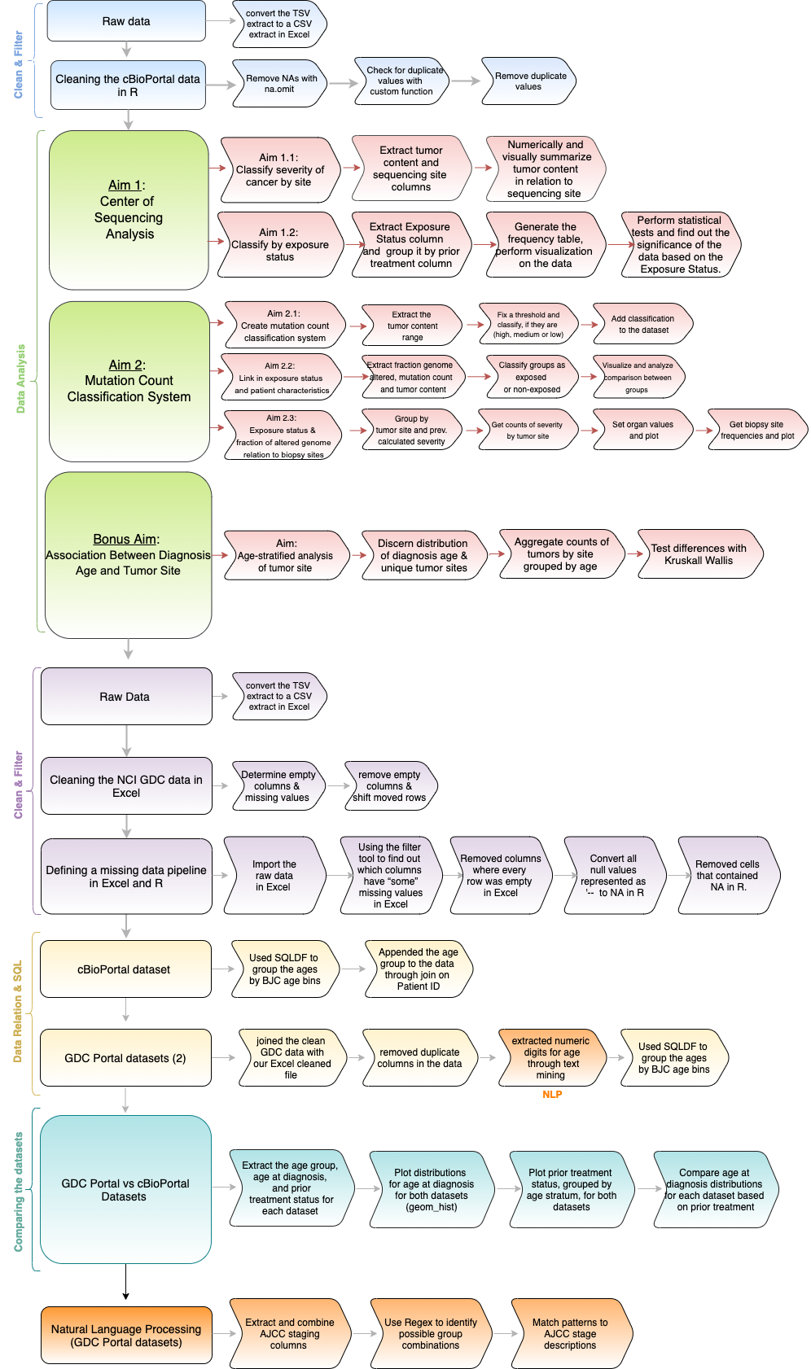
Project Pipeline
Notes:
AFSHA

Slide 6
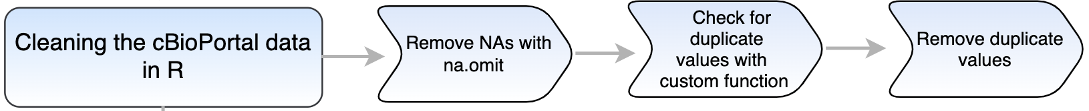
Cleaning of Dataset #1
CUSTOM FUNCTION
find_nonuniq <- function(dataset){
cols_nonunique <- c()
for(i in 1:ncol(dataset)){
if(length(unique(dataset[,i])) <= 1){
cols_nonunique[length(cols_nonunique) + 1] <- i #append the vector with the new columns
}
}
print(cols_nonunique) #print the vector
}
cols_nonunique <- find_nonuniq(complete_dat)
Notes:
AFSHA

Slide 7
Aim 1.1
Classify severity of cancer by site
Using data on sequencing sites and tumor content from cBio Dataset
Notes:
AFSHA -- ADD IN CBIO (confirm its CBIO lol)

Slide 8







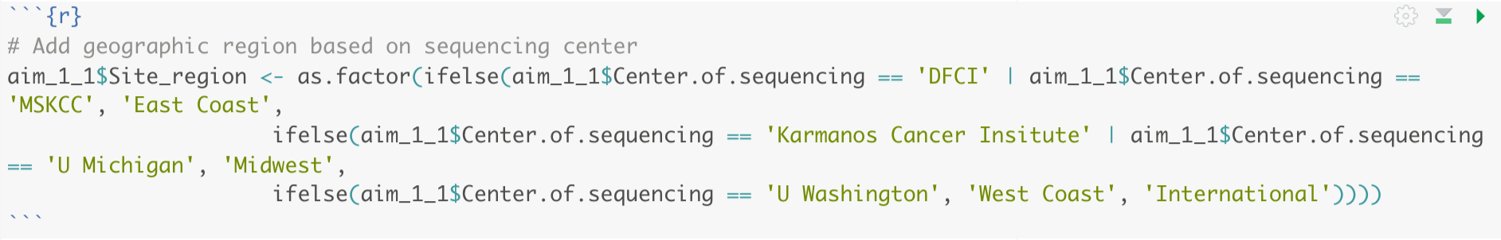
Aim 1.1 - Grouping Sequencing Centers by Region
Sequencing Centers
Geographic Region
Dana-Farber Cancer Institute
(DFCI)
Barbara Ann Karmanos Cancer Institute
Memorial Sloan Kettering Cancer Center
(MSKCC)
University of Michigan
University of Washington
Institute of Cancer Research and The Royal Marsden
(RM-ICR)
Midwest
East Coast
West Coast
International
Notes:
AFSHA
6 sequencing centers grouped into 4 regions
Used if-else statement as we learned in class to create the variables for region

Slide 9
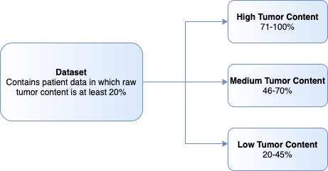
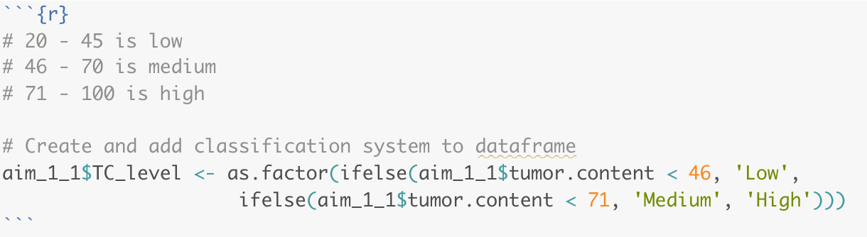
Aim 1.1 - Creating a tumor content classification system
Notes:
AFSHA
After reading the paper attached to the dataset, we learned that tumor content is recorded as a percentage in the dataset, and only patients whose tumor content was >20% were included in the study (and thus the dataset). Therefore, we split the range of 20-100 into three sections and classified these ranges as high, low, medium

Slide 10
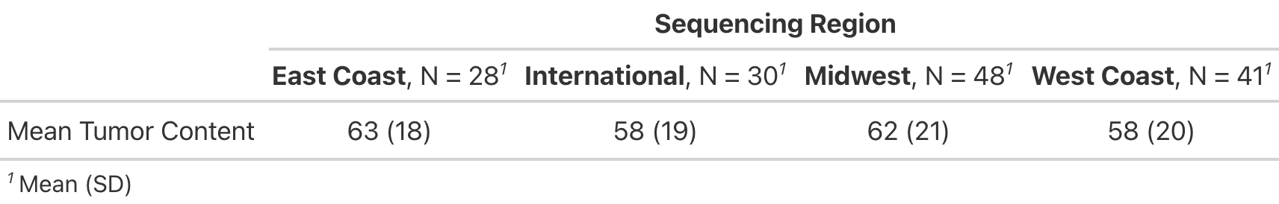
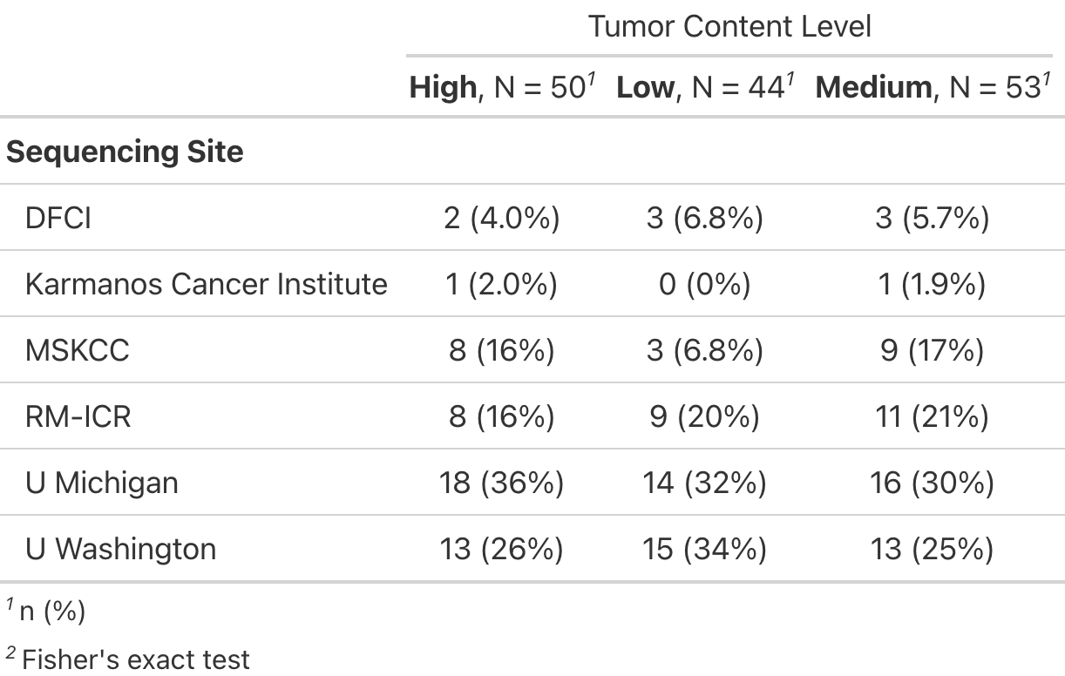
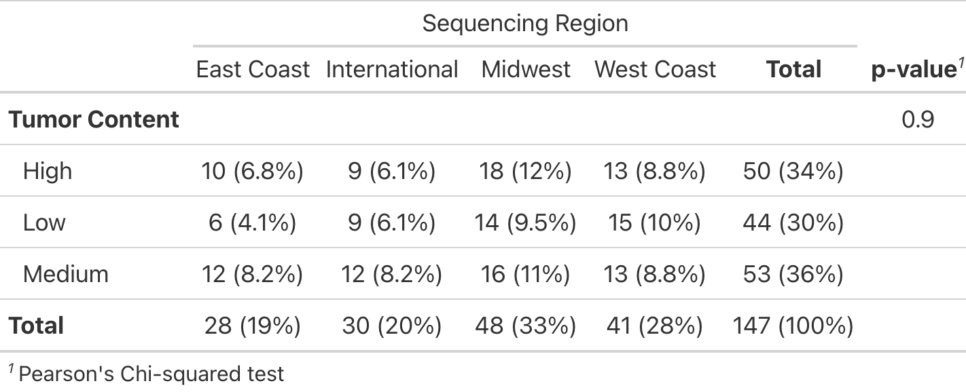
Aim 1.1 - Numeric Summaries
Table 1
Table 2
Table 3
Notes:
AFSHA
Table 1: Relatively even distribution of tumor content (raw %) across all geographic regions
Table 2: Across sequencing sites, the distribution of tumor content LEVELS (based on classification system) is also even
Table 3: Numeric summary of tumor content across geographic region (both based off classification systems I created). P-value shows that there is no significant association between geographic region and tumor content level

Slide 11
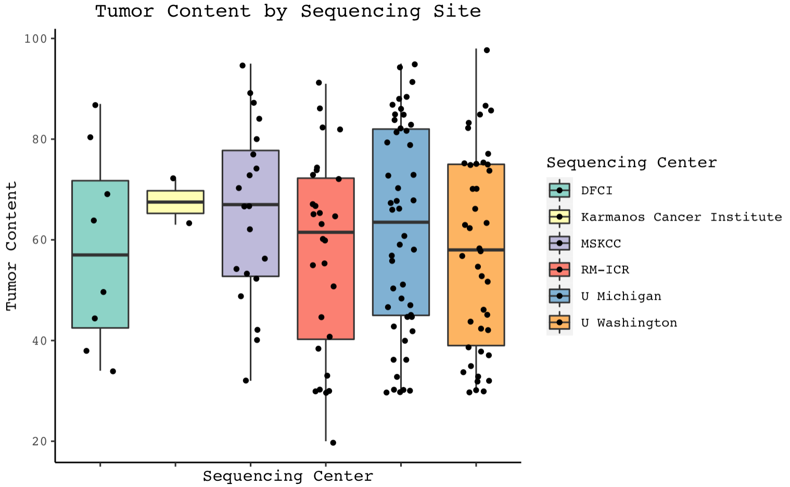
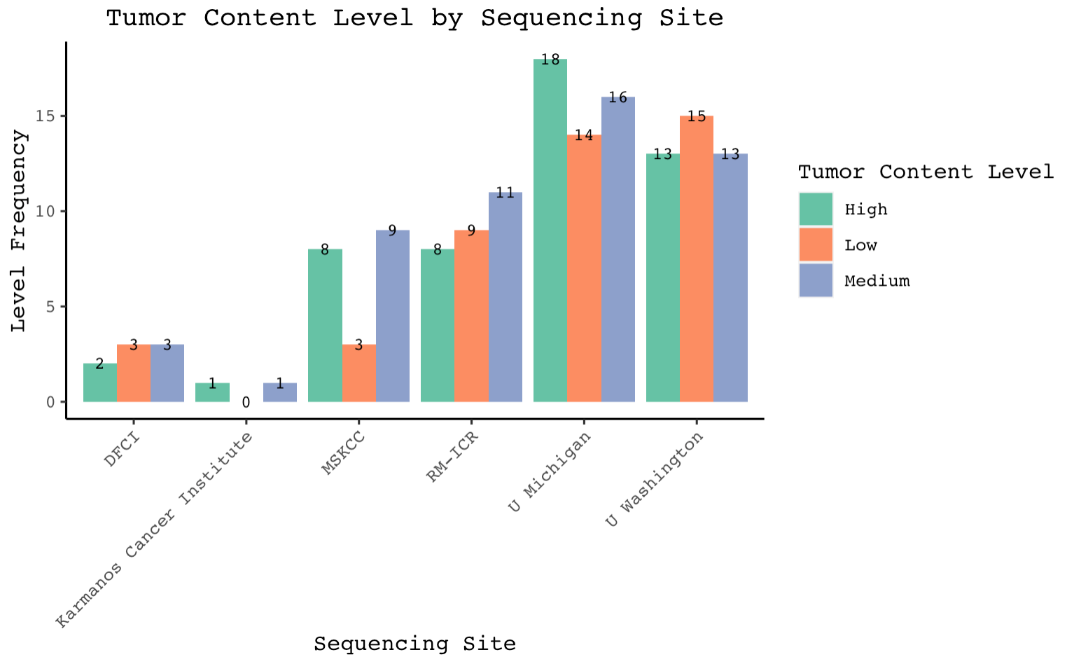
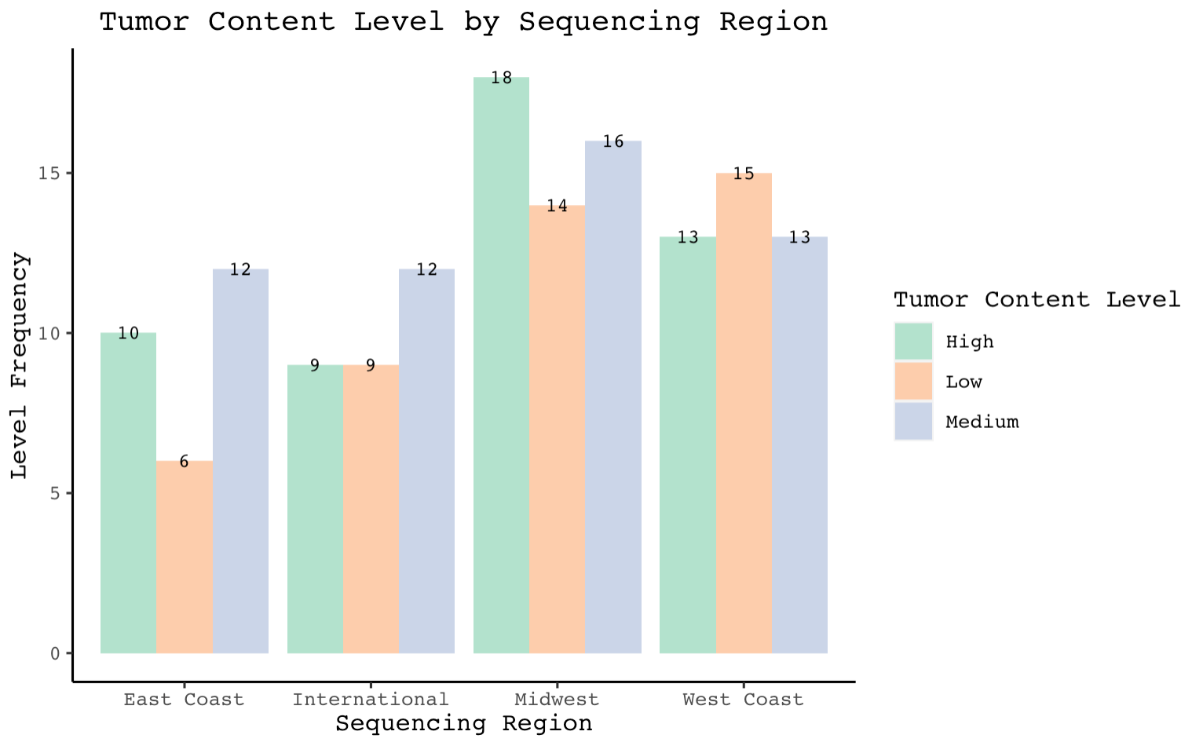
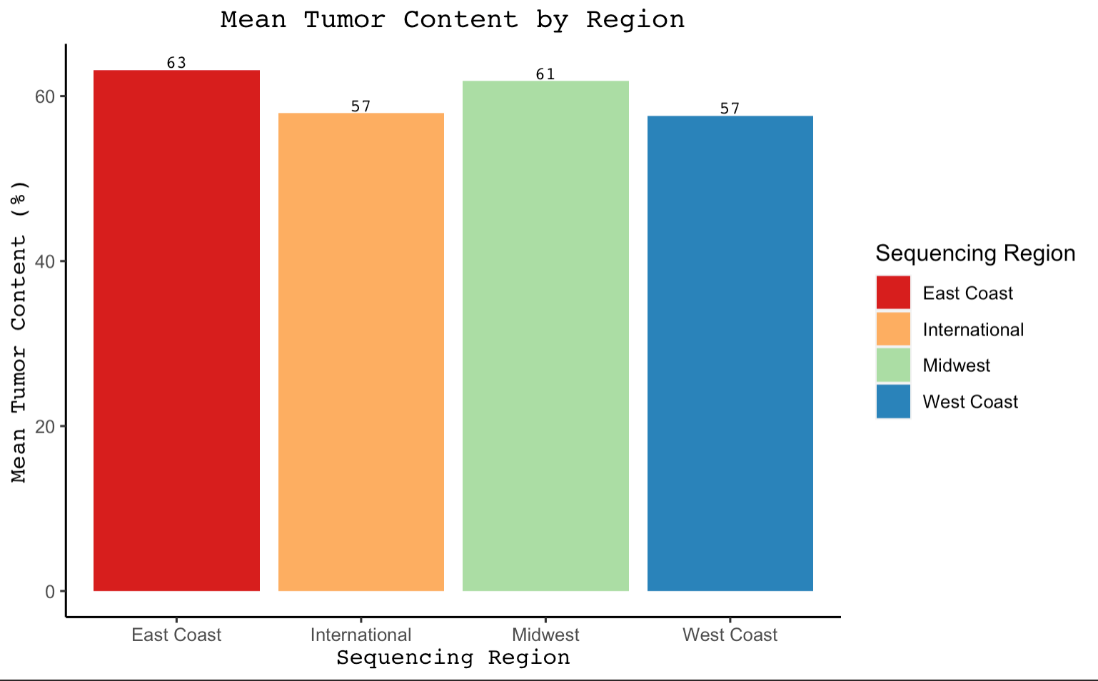
Aim 1.1 - Visualizations
Notes:
AFSHA
Visual representation of numeric summaries from last slide
Boxplot, Barplot, Grouped barplot
Overall, there seems to be an even distribution of tumor content whether its raw percentages or classification level across all the plot (when taking sample size into account for each site/region)

Slide 12
Aim 1.2
Classify severity of cancer by exposure status
Using data on sequencing sites and exposure status (grouped by prior treatment) from Dataset #1
Notes:
NOT AFSHA

Slide 13
Aim 1.2 - Classifying the Exposure status by Region (Grouped by Prior Treatment)
Dataset which contains the Exposure Status, Prior Treatment, Center of Sequencing
Use Janitor Library to classify Exposure Status and Prior Treatment by Center of Sequencing
Use the tabyl() method to generate multiple tables categorized by Center of Sequencing
Notes:
AYUSH

Slide 14
Aim 1.2 - Data grouped by prior treatment
Exposure.Status | Had Prior Taxane Treatment | No Prior Taxane Treatment
No | 1 | 10
Yes | 8 | 39
East Coast
Exposure.Status | Had Prior Taxane Treatment | No Prior Taxane Treatment
No | 1 | 54
Yes | 22 | 33
International
Exposure.Status | Had Prior Taxane Treatment | No Prior Taxane Treatment
No | 7 | 25
Yes | 12 | 4
Midwest
Exposure.Status | Had Prior Taxane Treatment | No Prior Taxane Treatment
No | 1 | 26
Yes | 9 | 5
West Coast
Notes:
AYUSH

Slide 15
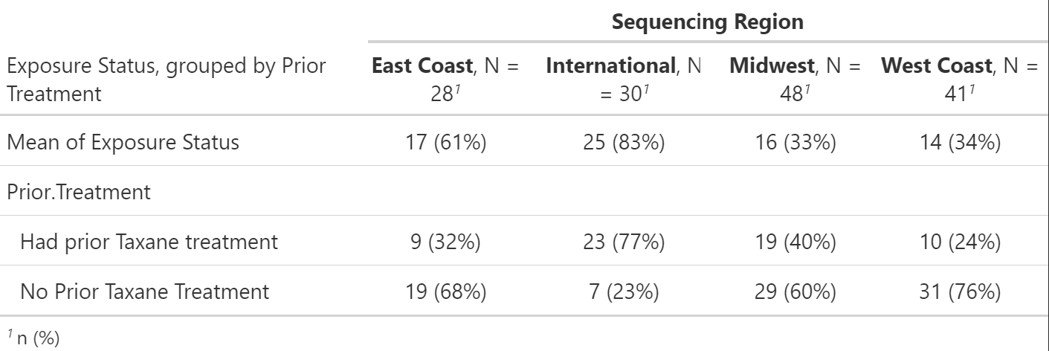
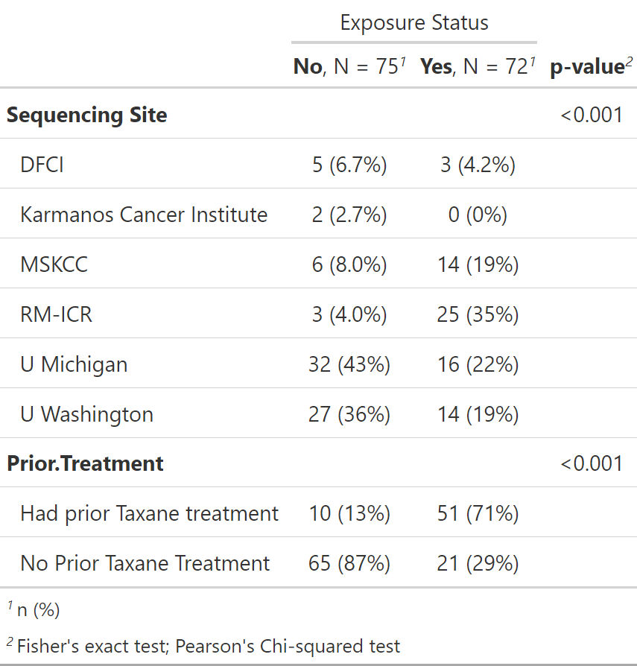
Aim 1.2 - Numeric Summaries
Table 1
Table 2
Notes:
AYUSH

Slide 16
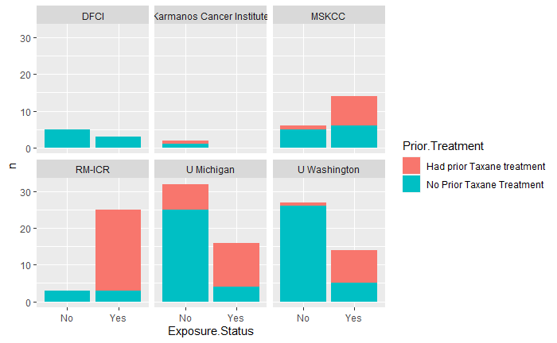
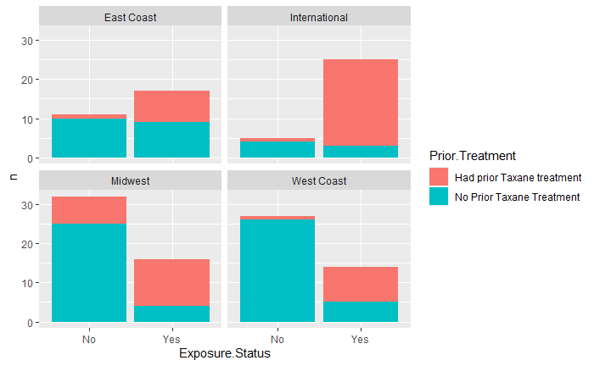
Aim 1.2 - Visualizations
Notes:
AYUSH

Slide 17
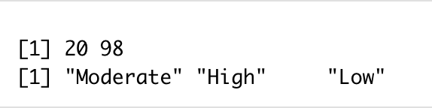
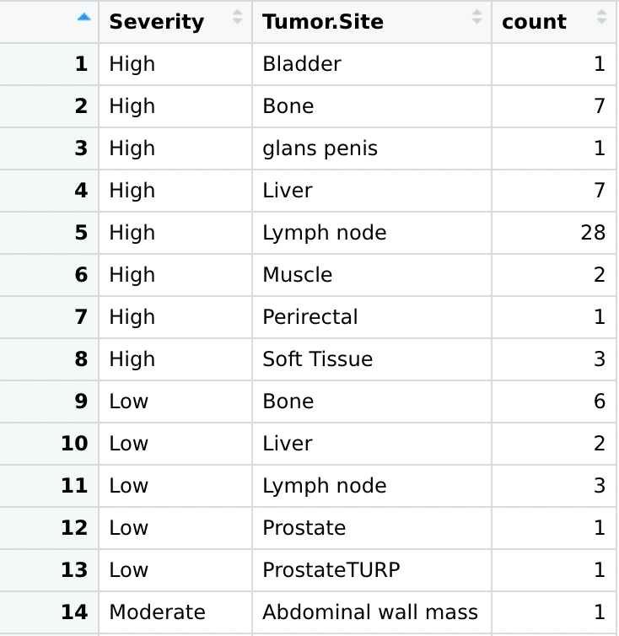
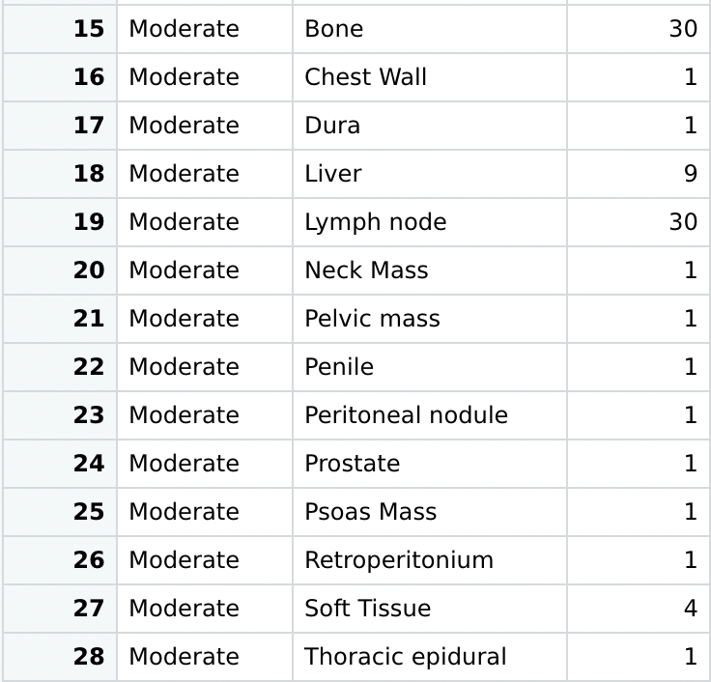
Aim 2.1 Assign classifications of “high”, “medium” or “low” based on the intensity of tumor content
1 to 10 mutations are needed for cancer to emerge
Notes:
Subjects were classified as high mutation count if the filtered somatic mutation count was above the bottom tertile of their cancer type.
20-45
46-70
71-100

Slide 18
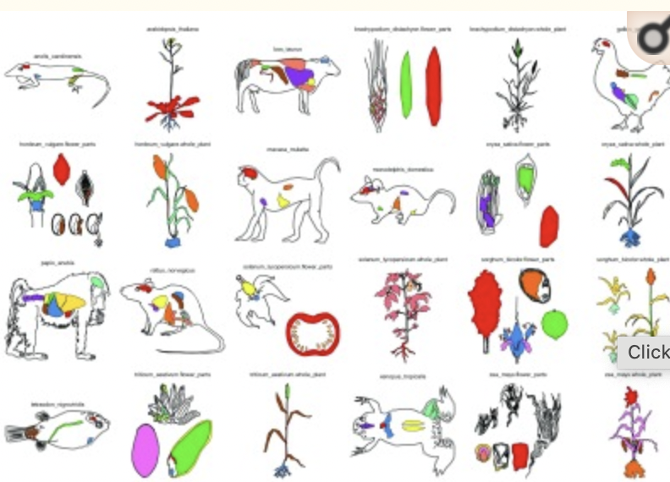
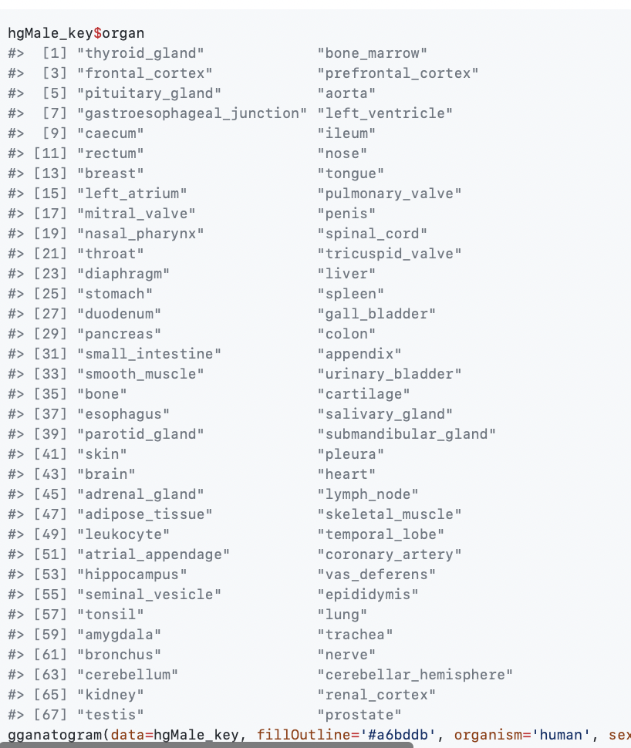
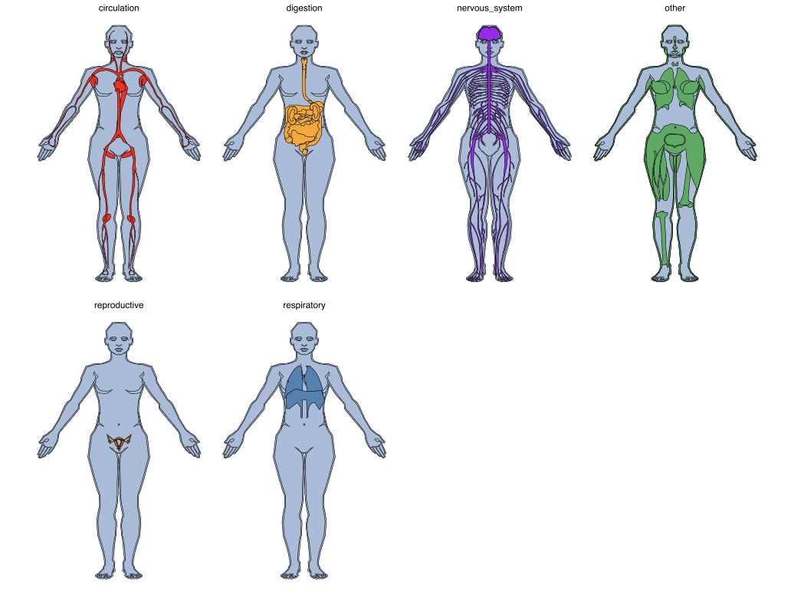
Aim 2.1
Now based on the data that was obtained from our last step we can plot.
To plot we will use the “gannatogram library”
Notes:
Initally we need to make a dataframe , in a order by nameing the organs exactly as built in the package "gganatogram"

Slide 19
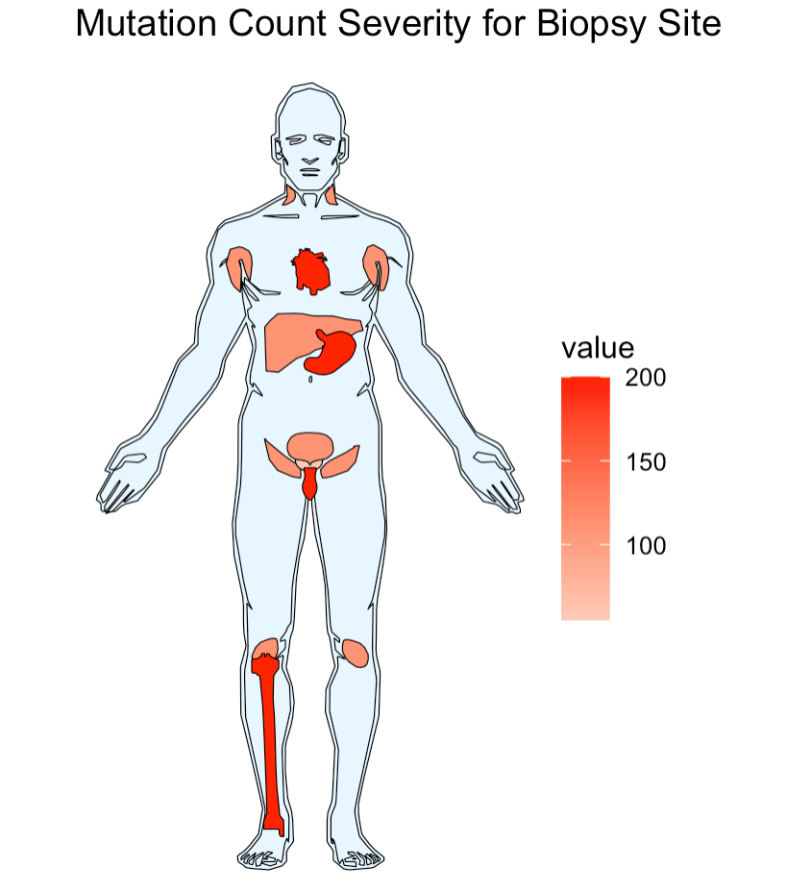
Aim 2.1
Notes:
PARI

Slide 20
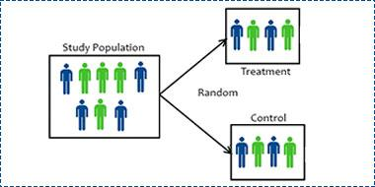
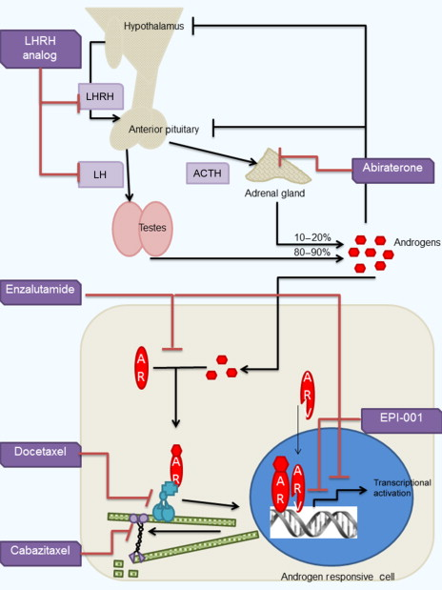
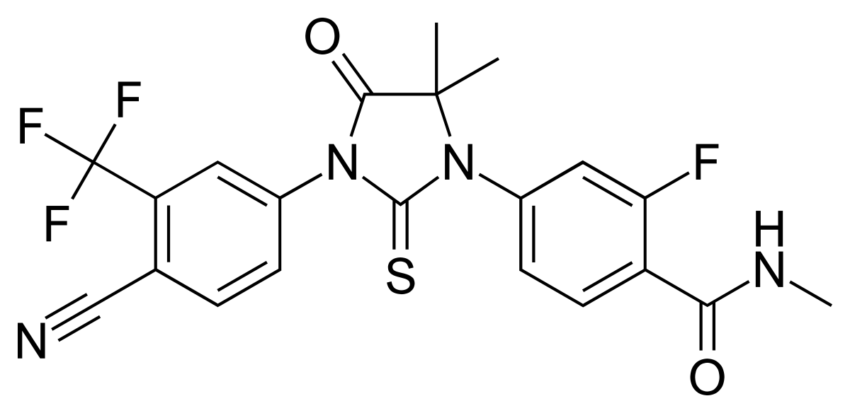
Aim 2.2 Is tumor content, mutation count or fraction genome altered related to ABI/ENZA Exposure?
Notes:
ALISA

Slide 21
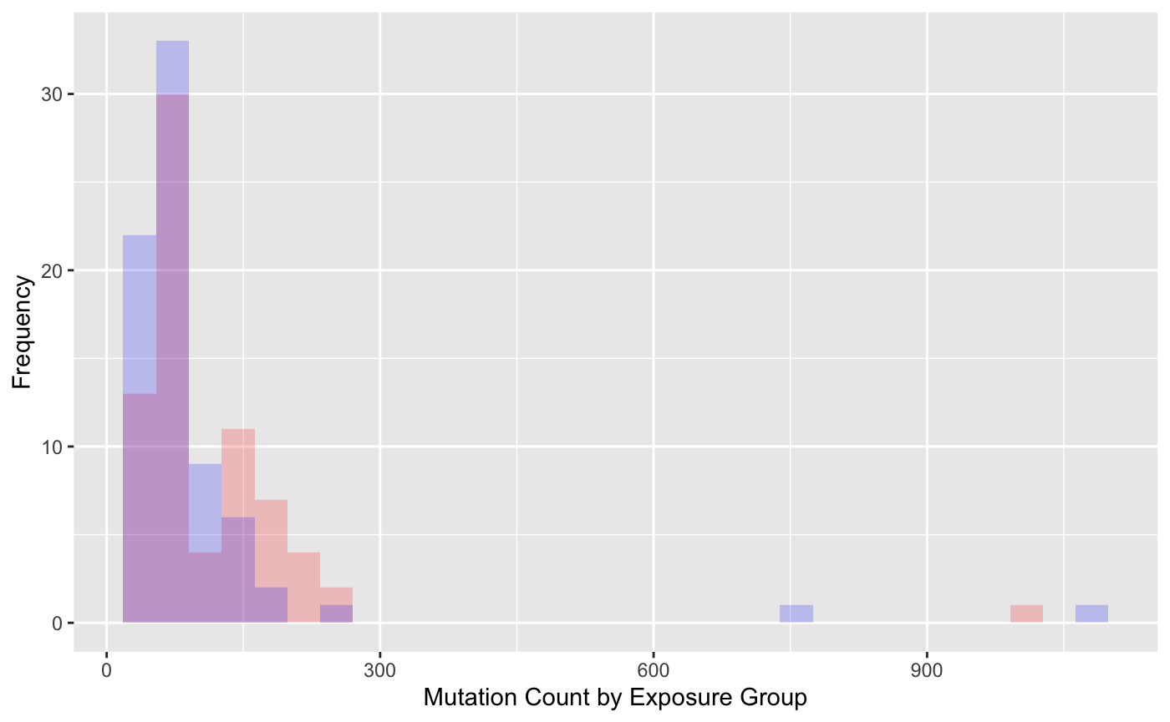
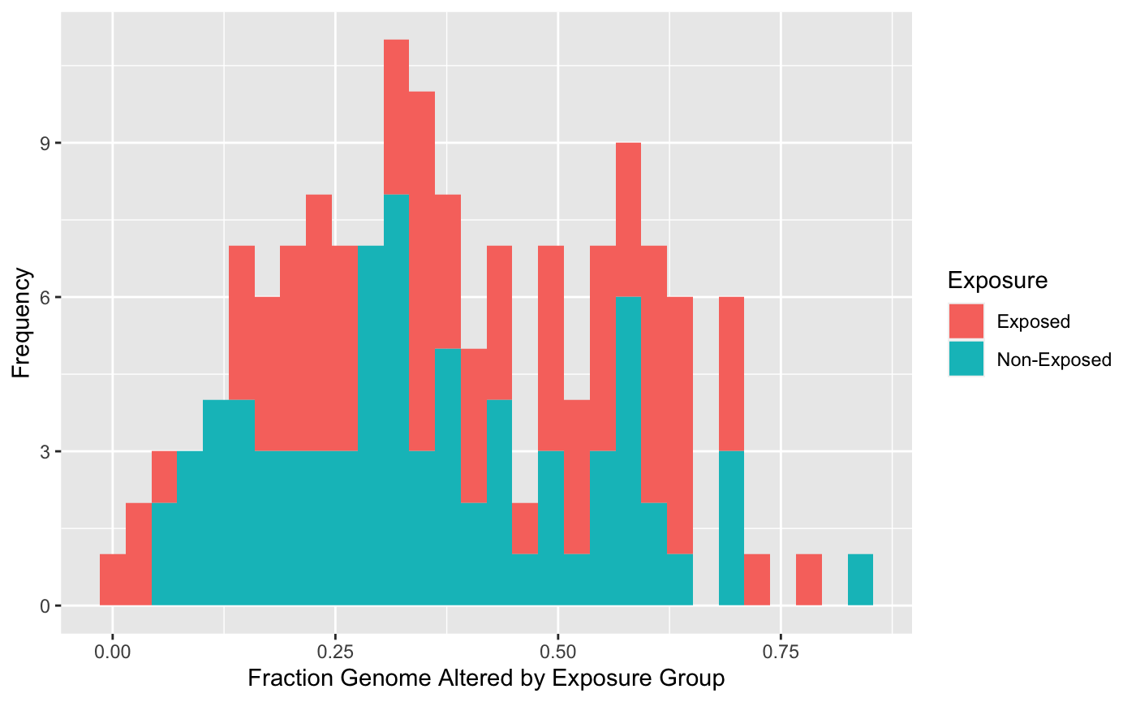
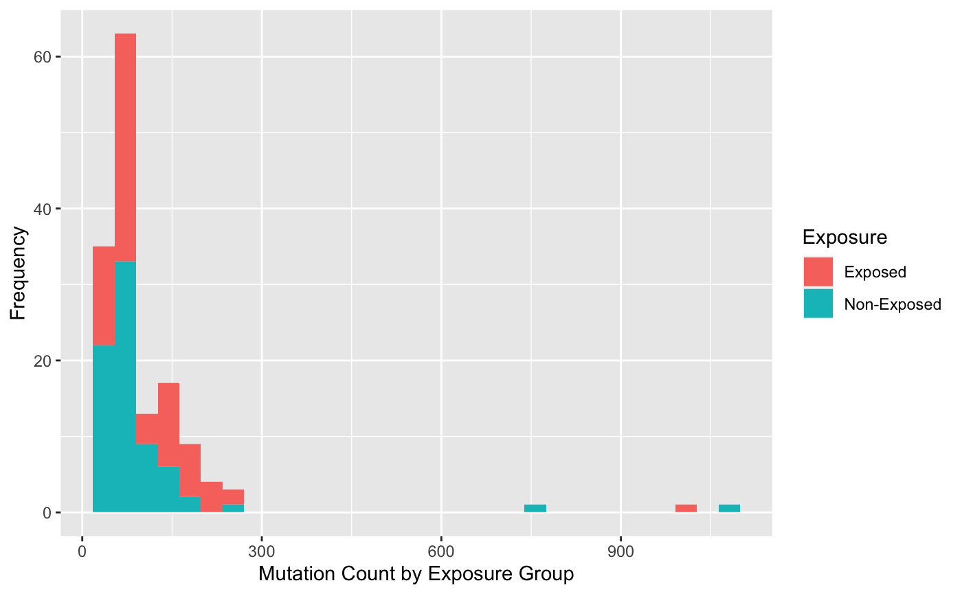
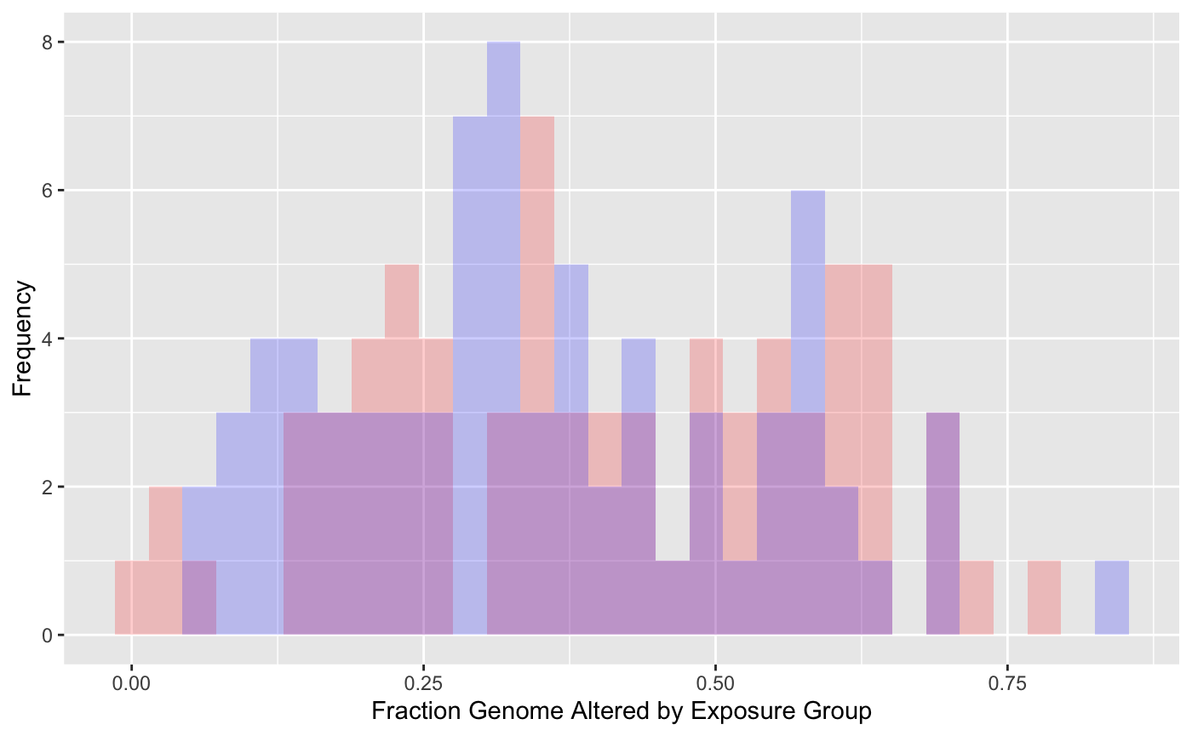
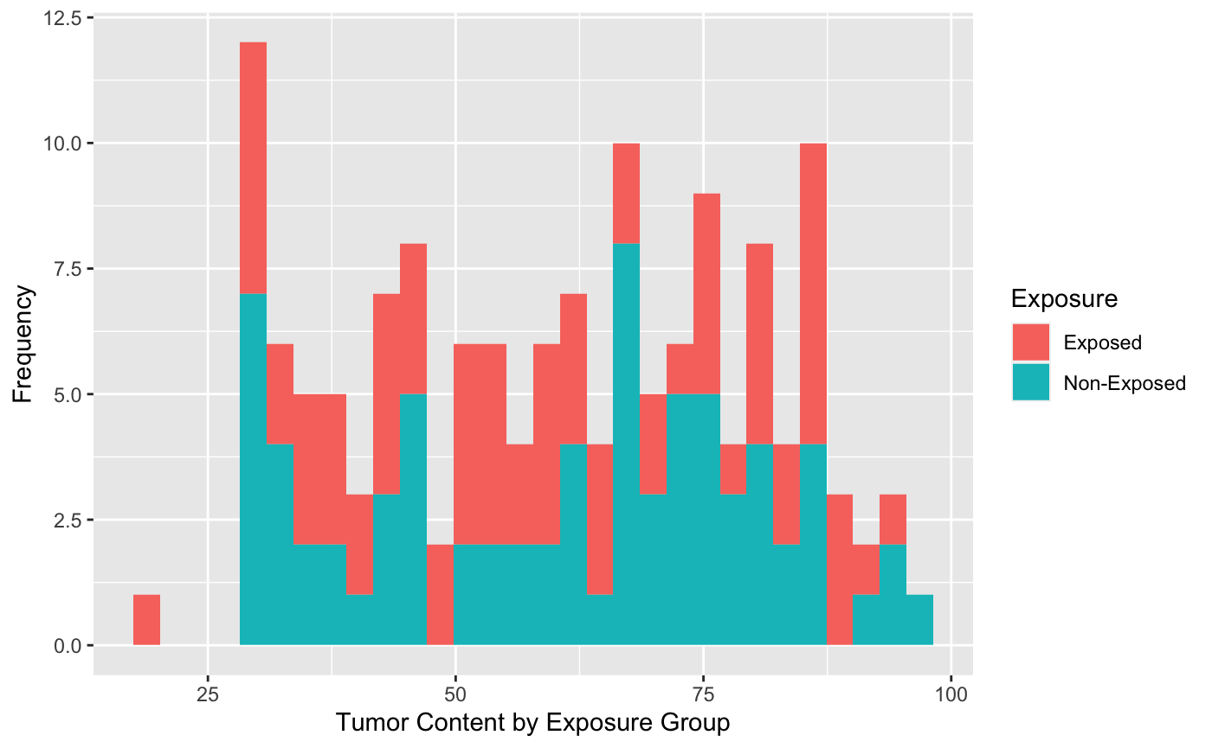
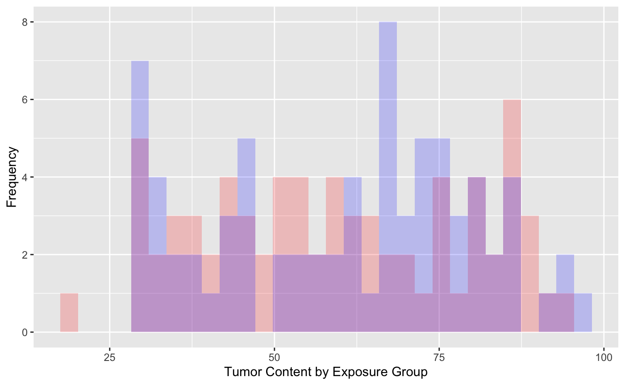
Aim 2.2 Visualization
Notes:
ALISA

Slide 22
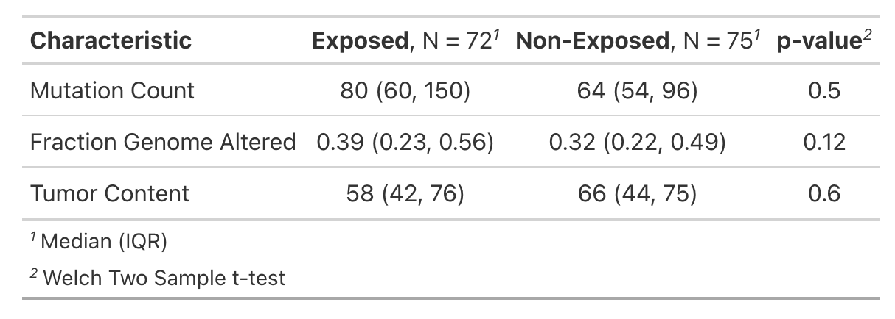
Aim 2.2 Analysis
Notes:
ALISA

Slide 23
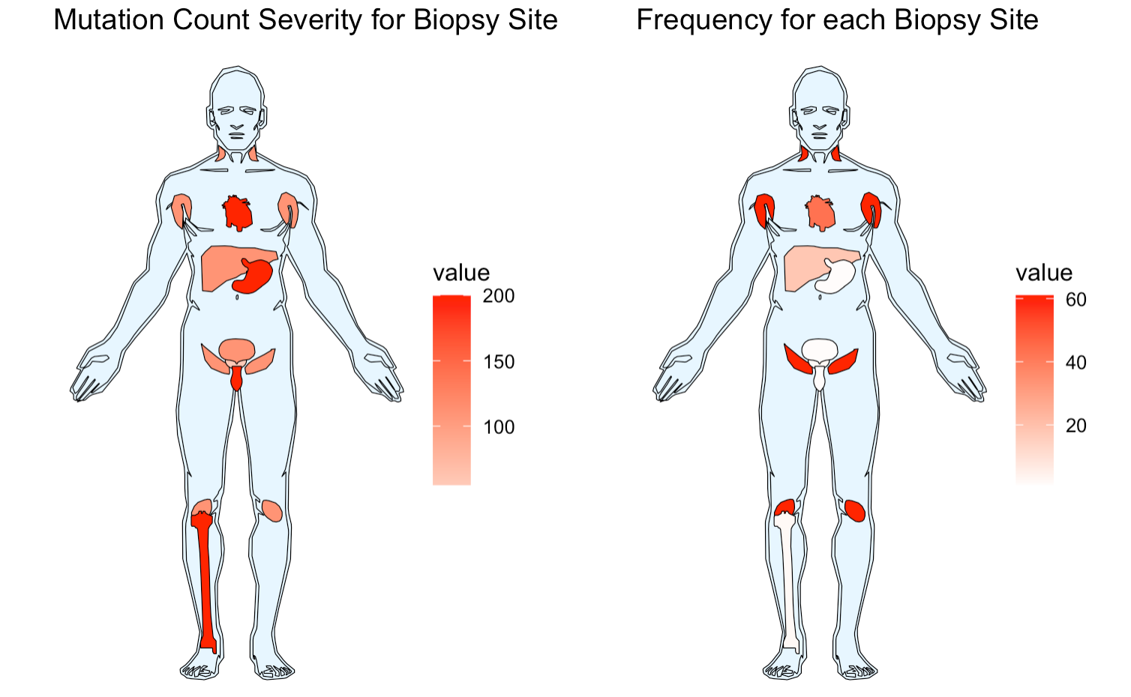
Aim 2.3:Are these then related to biopsy sites?
Notes:
PARI/ALISA

Slide 24
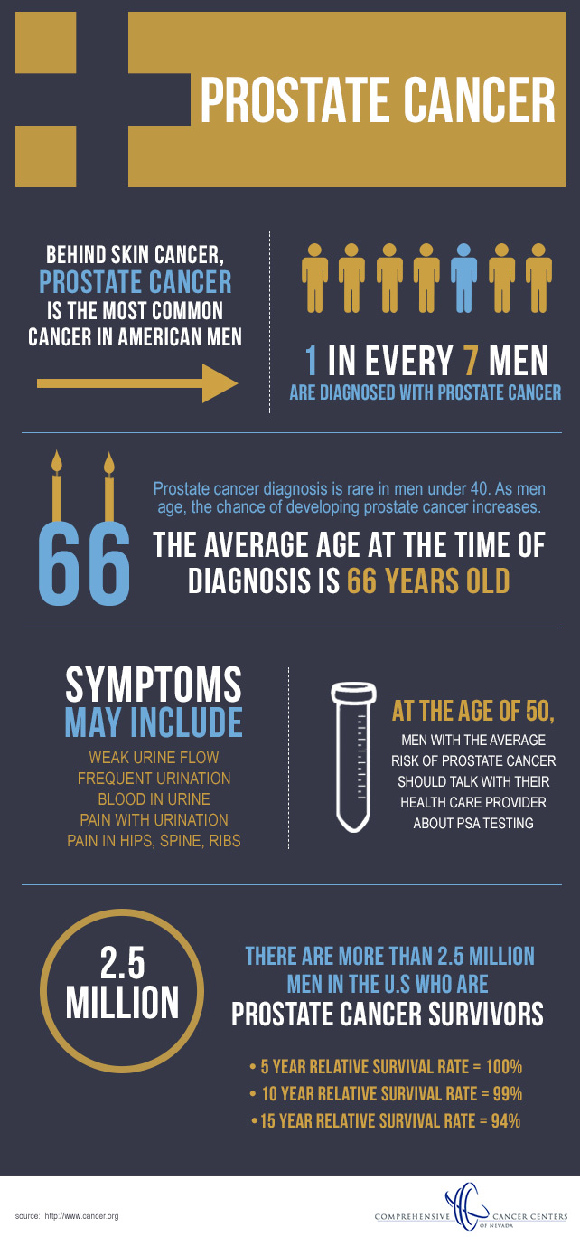
AIM: Check for association between diagnosis age & tumor site
Notes:
JESS
Stats range from 1 in 6 to 1 in 8 men will be diagnosed with prostate cancer in their lifetime
6 out of 10 cases according to the american cancer society are diagnosed in men aged 65 and older
Mean age of diagnosis for our data was ~67 years old
As men age they have an increased risk of developing prostate cancer
Bone most common site for metastatic disease
Aim to determine if these two prior notions hold true with our data

Slide 25
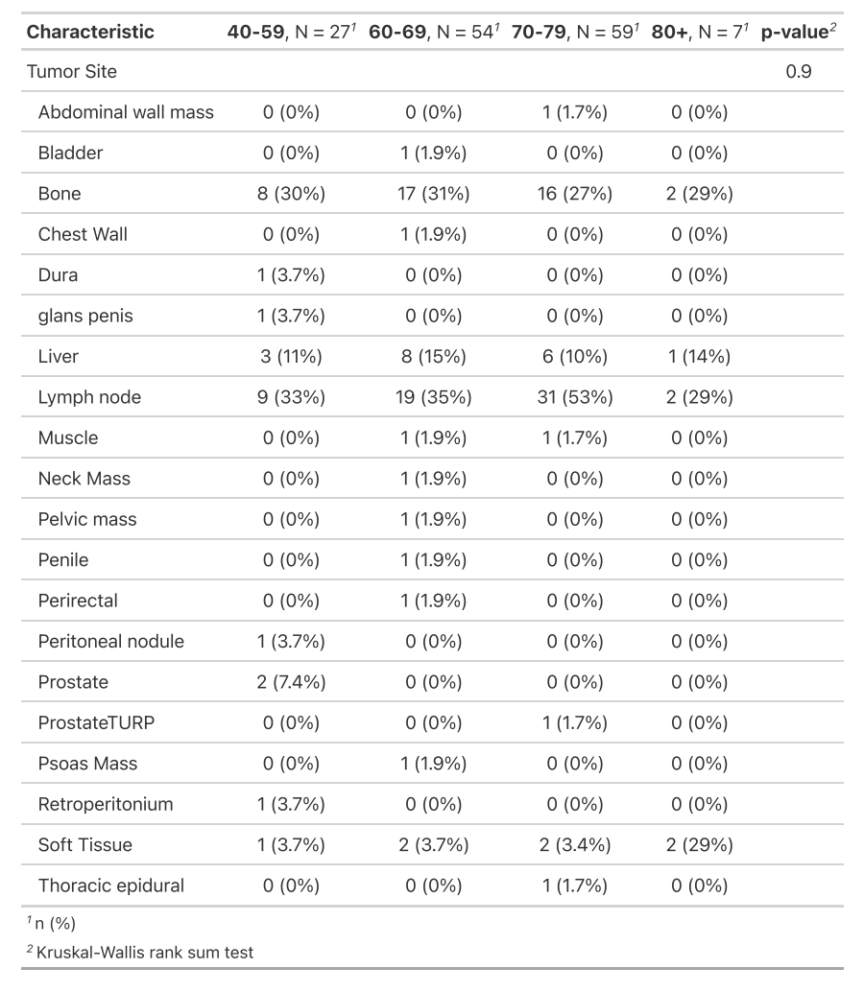

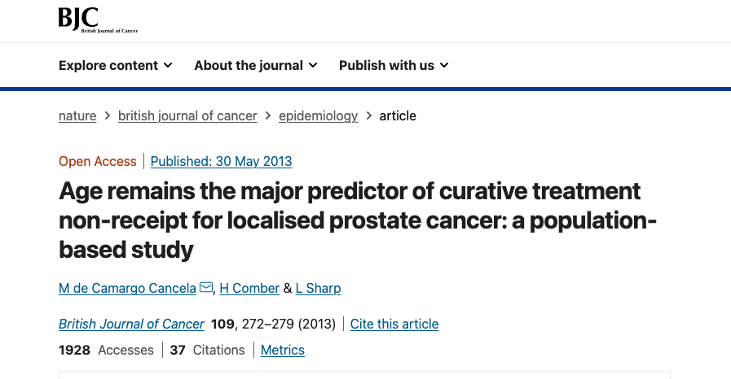
Bonus Aim
Notes:
JESS
We did a quick summary of the data and learned the minimum age was 40 at diagnosis while the maximum age at diagnosis was 85
We needed a way to age-striatify the data to be able to compare these 20 tumor sites to the age at diagnosis
Paper published in the British Journal of Cancer conducted population based study of prostate cancer with an age-stratified analysis grouping the ages in this manner so i employed the same age stratification
After age stratifiying the data we assessed the aggregate counts of tumor by site grouped by age
Several of the counts were 0 or 1 in most cases with the exception of the 5 sites highlighted here
We performed a kruskal wallis rank sum test to assess whether the differences among the age stratified ranks were significant by tumor site
P-value was 0.9 assuming 0.05 alpha significance -- demonstrates no significant difference among age ranks by tumor site

Slide 26
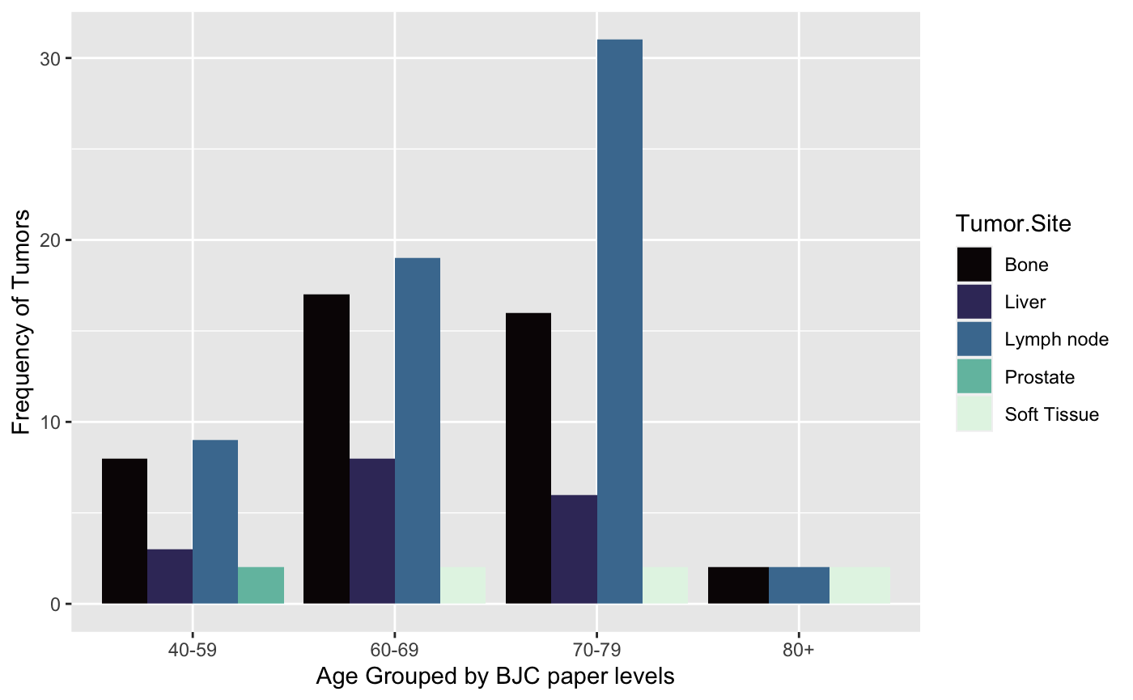
Distribution of tumors by site and age group, where the frequency of tumors was greater than 1
Notes:
JESS
Further investigated the five tumor sites where quantity of aggregate counts was greater than 1 as we were interested in determining whether the prior notion that bone was the site of greatest metastatic disease held true
Bone not most common site of metastatic disease from this study
Lymph nodes had 61 total tumors bone had 43
“60-69” age group and “70-79” group experienced the most tumors proportionally as would be expected given that as men age the likelihood of developing prostate cancer increases
If time permitted we would have further calculated the incident rate ratios per age group for the five tumor sites where frequency was greater than 1 to understand the proportional burden of disease experienced by each age group.
Data limited given that the population was a bit skewed toward the older age groups (60-79) with very few cases representing those older than 80
More information as to prognosis and vital status beyond age 80 would be beneficial in determining whether the assumption of age and incidence is valid.

Slide 27
Dataset #2
National Cancer Institute: GDC Portal
Notes:
PARI

Slide 28
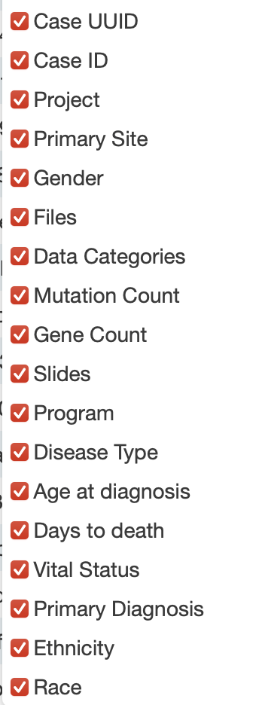
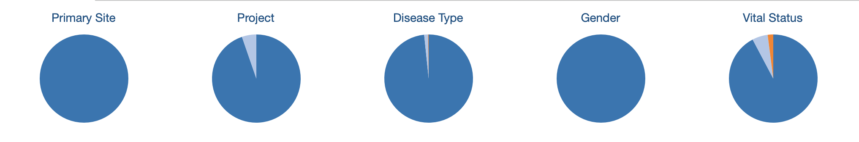
\
CASES-493
DATASET1->MAY15
DATASET2->JUNE 15 (ON GOING)
Notes:
About dataset2 (clean on from the gdc portal)
May15
New june 15
And its a on going repo , gets from multiple research

Slide 29
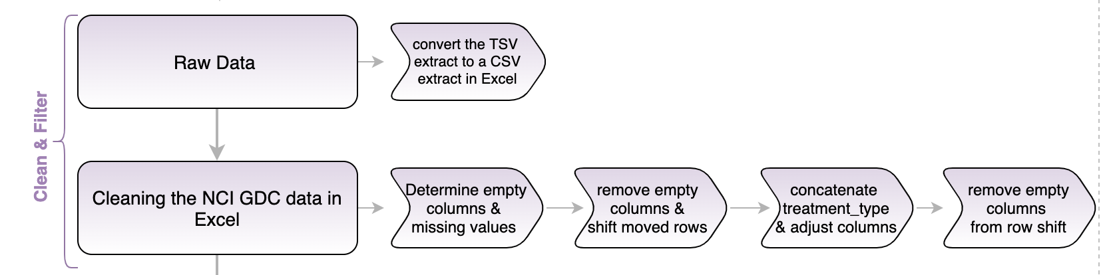
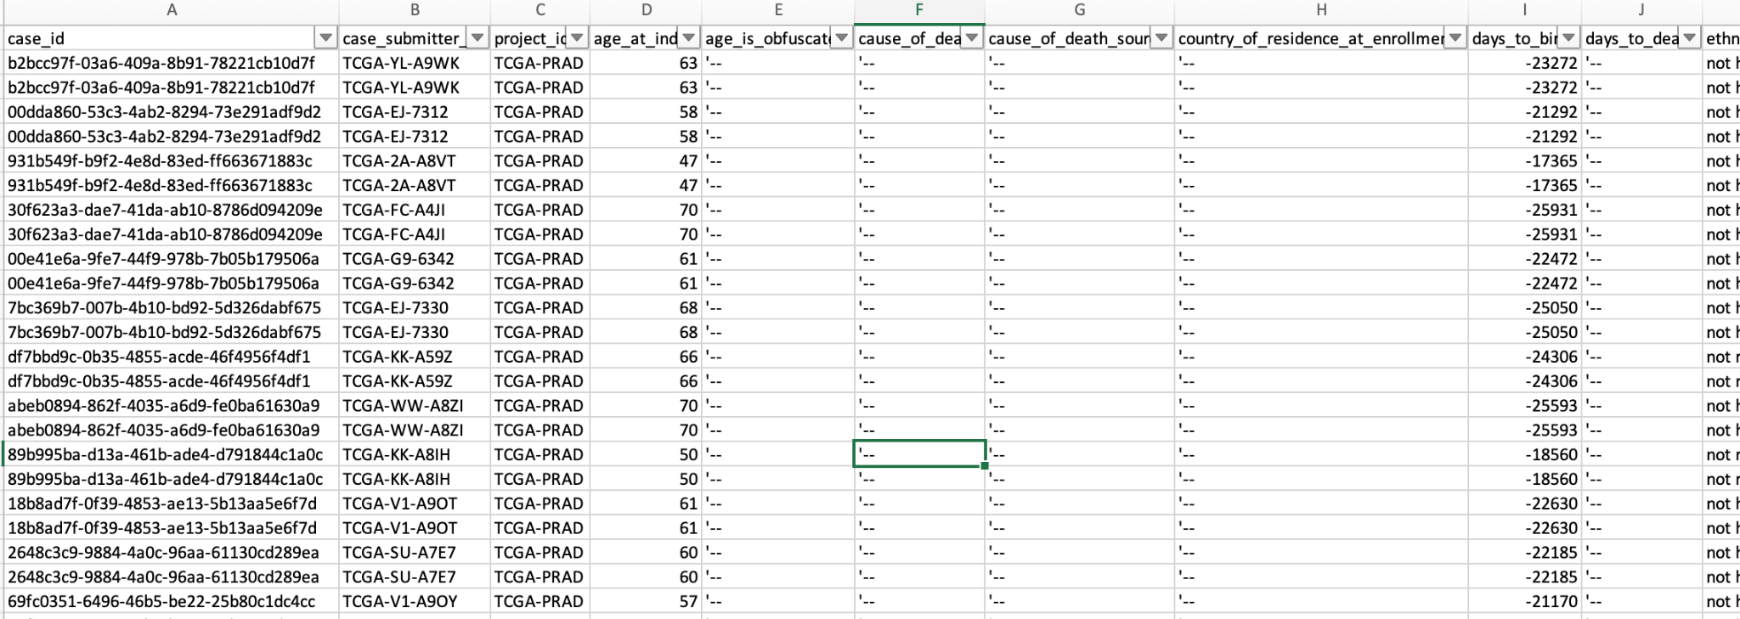
Data set #2 cleaning
Notes:
JESS
-The raw data contained 960 rows and 156 columns.
- Missing values were those marked as '-- in the cells.
-112 empty columns for which no data was available and 33 columns with missing values
-several rows were shifted so we had to account for that
-towards the end of the data the values for treatment type were split into “Pharmecutical Therapy and Radiation Therapy” and NOS so we concatenated the string into treatment_type

Slide 30
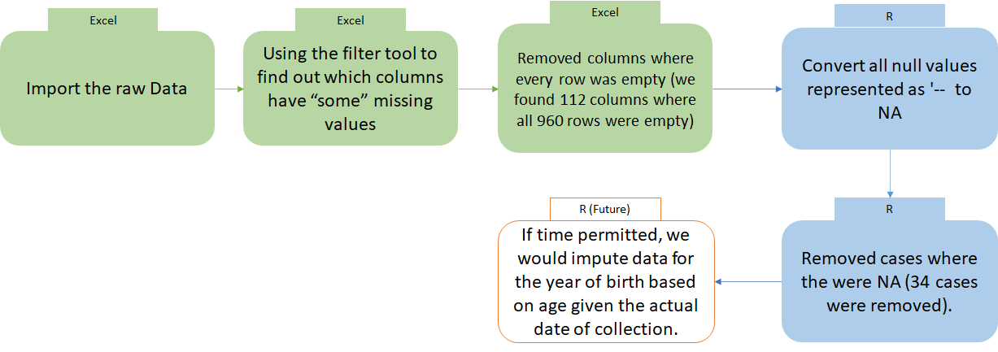
Missing Value Pipeline
Notes:
AYUSH

Slide 31
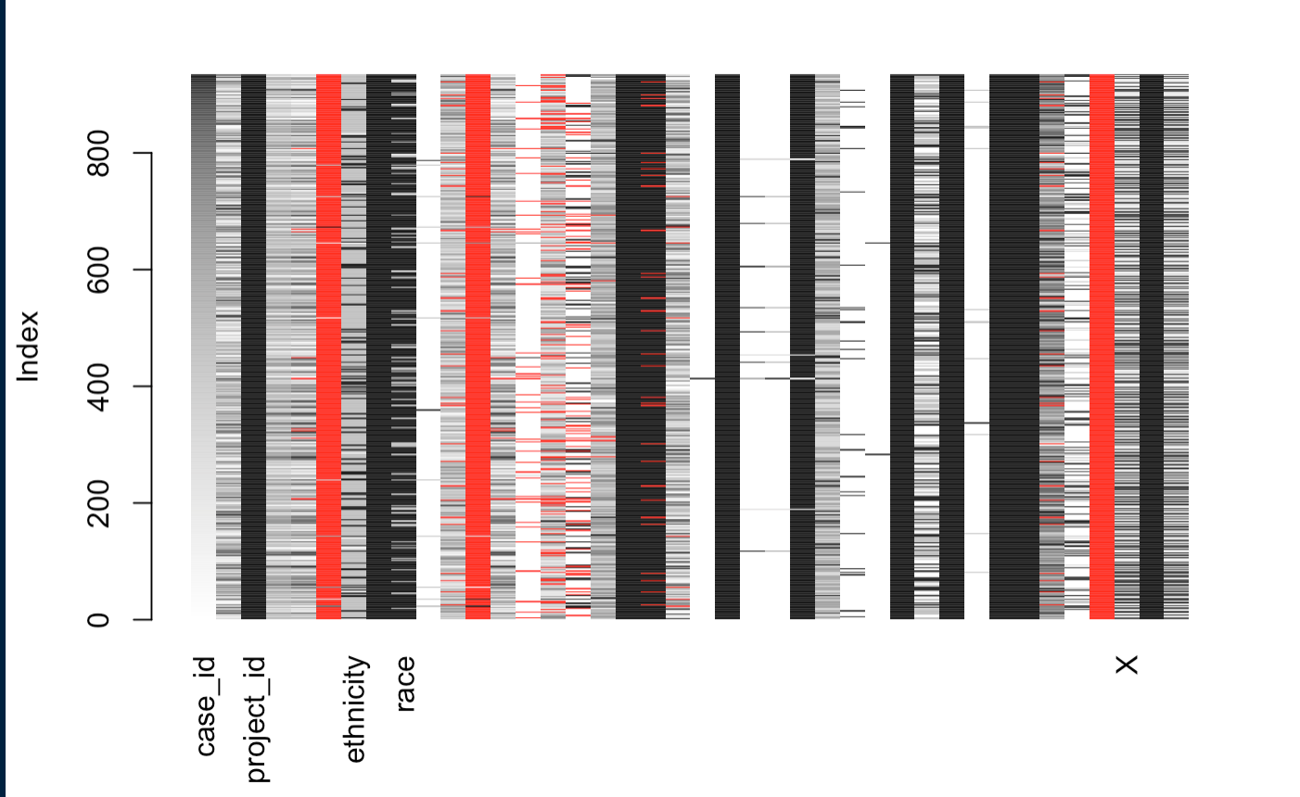
Relationship between missing variables by CaseId
Notes:
JESS
Explored the relationship between the missing variables sorted by Case ID
Columns 6 , 12, and 37 which correspond to days_to_death, year of death and treatment type are all red as they were fully populated with NAs
However columns 14, 15, and 16 which describe the clinical stage of the tumor, regional node and metastases are clearly correlated with the case Id as distinguished by the red values

Slide 32
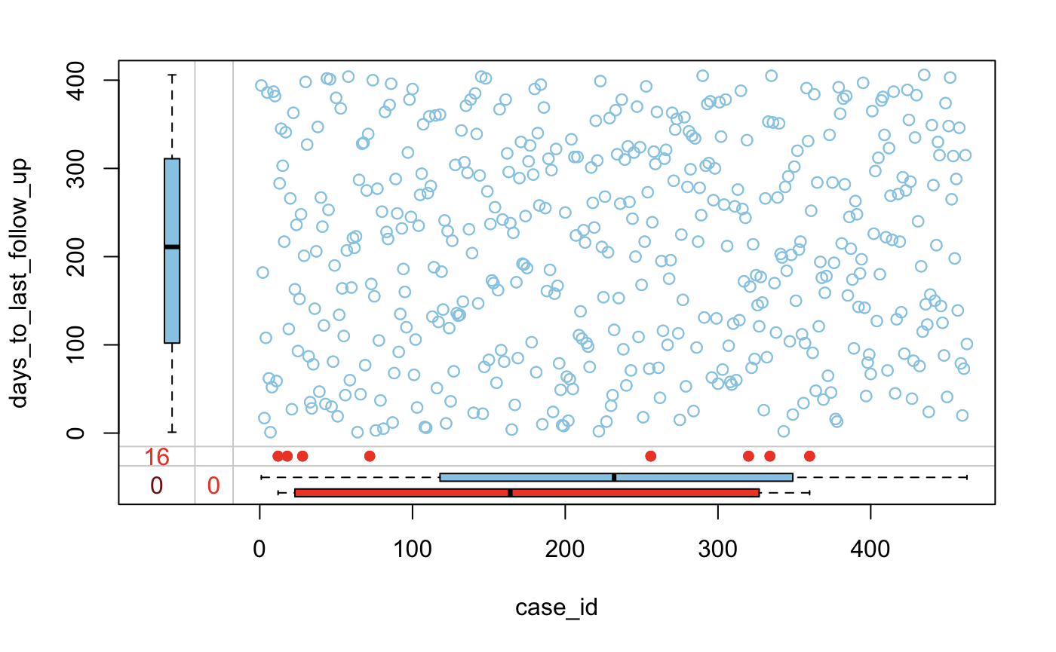
Missing values of days to last follow up broken down by case
Notes:
JESS
Here we have a scatterplot in blue relating the observed values of days to last follow up by case
The missing values are shown by the dots in red on the dot plot
The boxplots here show the contrast in distribution of the missing values to the observations

Slide 33
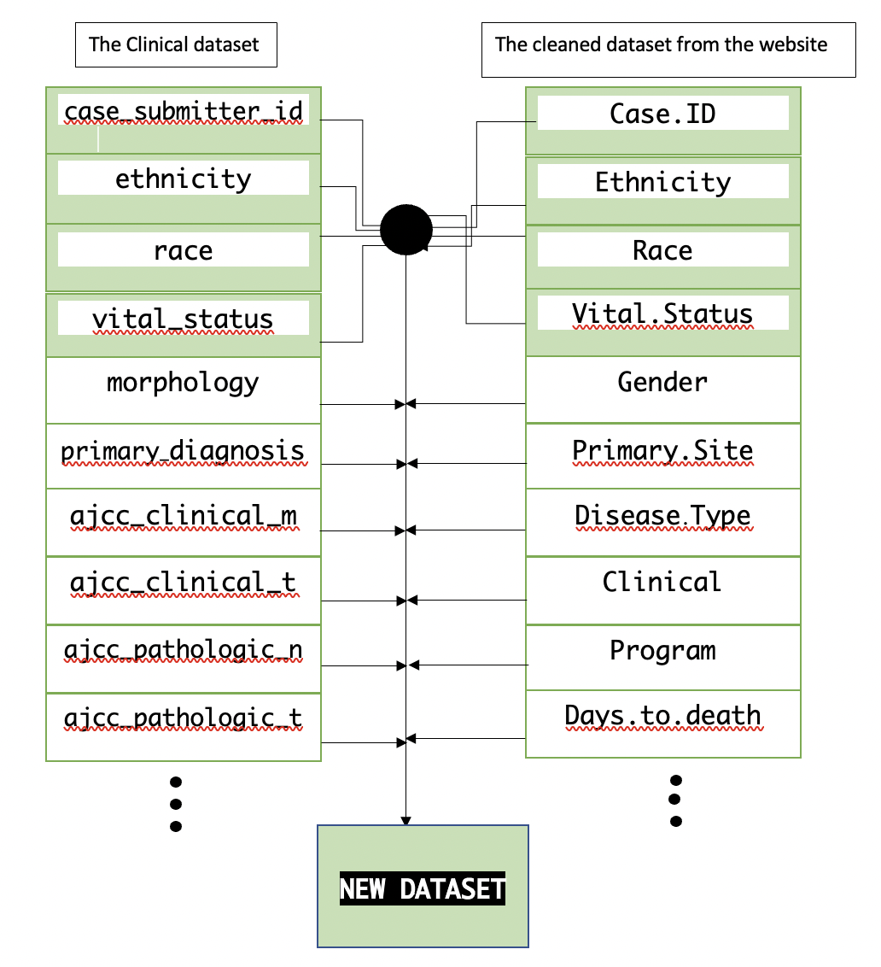
Relational Data Diagram
Notes:
PARI

Slide 34
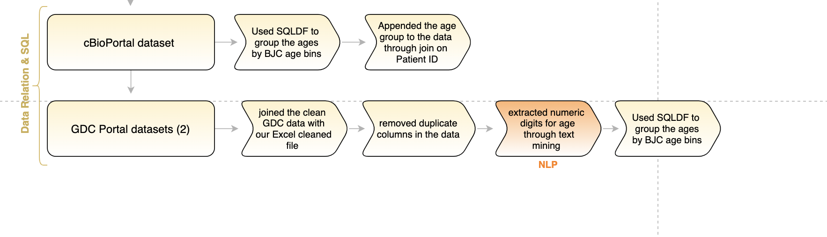
SQL Relational Data
SQL SYNTAX IN R
dataset_1sql <- sqldf("SELECT ID, case when Age >=40 and Age <= 59 then '40-59'
when Age >59 and Age <= 69 then '60-69'
when Age >69 and Age <= 79 then '70-79'
else '80+' end
FROM dataset_1 GROUP BY ID,
case when Age >=40 and Age <= 59 then '40-59'
when Age >59 and Age <= 69 then '60-69'
when Age >69 and Age <= 79 then '70-79'
else '80+' end")
Notes:
JESS

Slide 35

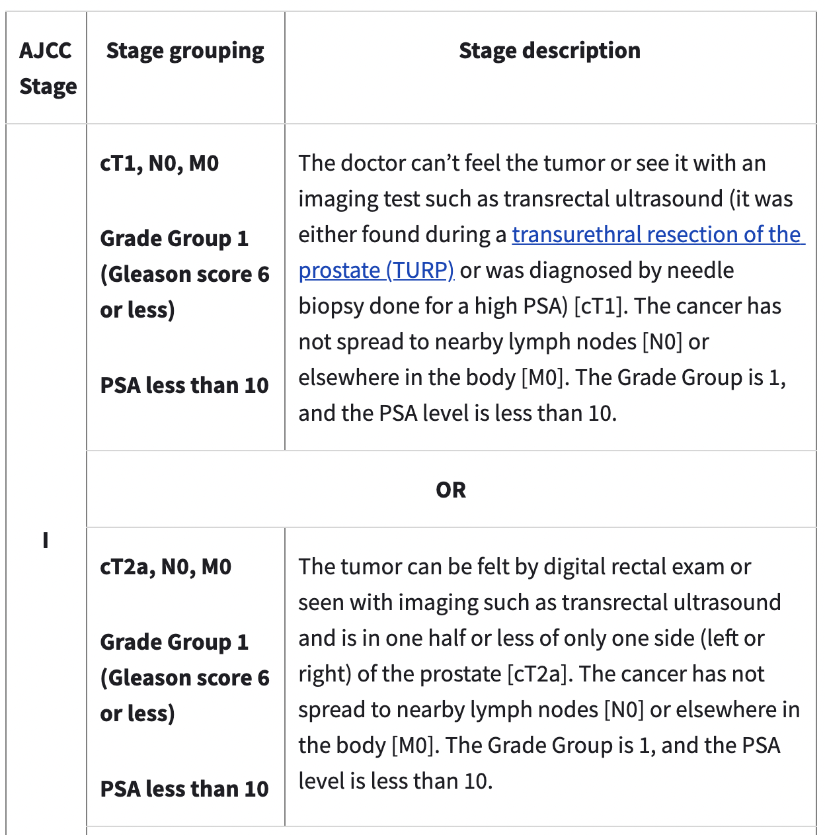

Natural Language Processing
Notes:
ALISA

Slide 36


Natural Language Processing
R Code for Classification
classifications = c(
"The cancer has not spread to nearby lymph nodes or elsewhere in the body. The Grade Group is 1 , and the PSA level is less than 10.",
"The cancer has not spread to nearby lymph nodes [N0] or elsewhere in the body [M0]. The Grade Group is 1. The PSA level is at least 10 but less than 20.",
"The cancer has not spread to nearby lymph nodes [N0] or elsewhere in the body [M0]. The Grade Group is 2. The PSA level is less than 20.",
"It has not spread to nearby lymph nodes [N0] or elsewhere in the body [M0]. The Grade Group is 1 to 4, and the PSA can be any value.",
"The cancer has spread to nearby lymph nodes [N1] but has not spread elsewhere in the body [M0]. The Grade Group can be any value, and the PSA can be any value.",
"It has spread to other parts of the body, such as distant lymph nodes, bones, or other organs [M1]. The Grade Group can be any value, and the PSA can be any value.",
"Not classified"
)
Notes:
ALISA

Slide 37

Natural Language Processing
Notes:
ALISA

Slide 38
Custom Function Library: ‘DiseaseDivas’
CUSTOM FX 1 : Remove Non-Uniques
checks for values that are the same within a column
CUSTOM FX 2: Change string value to NA
checks for the following string value ‘-- and changes it to NA
CUSTOM FX 3: Carbon Copy
checks for columns that are duplicated
Notes:
AYUSH

Slide 39
Concluding Remarks
Limitations
Significance
1st Dataset:
Variables not well-defined
Prostate cancer is niche
No evidence of association between geographic location and severity of tumor content
As men age, incidence of prostate cancer increases with metastasis of disease occurring more frequently in the lymph nodes and bone.
Strong evidence of association between geographic location and Exposure Status based on Prior Treatment Status was found.
Notes:
Afsha

Slide 40




Next steps: Investigate Treatment Effect on Age at Diagnosis
Dataset 1
Dataset 2
Notes:
AFSHA
** CHANGE FREQUENCIES TO PROPORTIONS
Taxane ttreatment/no treatment group → has higher mean/median age at diagnosis? If so, taxane treatment may be helpful in delaying cancer?? Dataset 1 → no vital stats

Slide 41
Bibliography:
https://pubmed.ncbi.nlm.nih.gov/26000489/
https://portal.gdc.cancer.gov/exploration?filters=%7B%22content%22%3A%5B%7B%22content%22%3A%7B%22field%22%3A%22genes.is_cancer_gene_census%22%2C%22value%22%3A%5B%22true%22%5D%7D%2C%22op%22%3A%22in%22%7D%5D%2C%22op%22%3A%22and%22%7D
https://www.google.com/search?q=cell+journal&source=lnms&tbm=isch&sa=X&ved=2ahUKEwjOgtLV7In0AhWwoXIEHbAqC3kQ_AUoAnoECAEQBA&biw=1797&bih=817&dpr=1#imgrc=HTERdPOrc0-NoM
https://www.cancer.org/cancer/prostate-cancer/about/key-statistics.html
https://cccnevada.com/prostate-cancer-by-the-numbers/
https://twitter.com/brjcancer/status/920966252994203648
https://www.nature.com/articles/bjc2013268#Tab1
https://www.sanger.ac.uk/news_item/1-10-mutations-are-needed-drive-cancer-scientists-find/
https://ascopubs.org/doi/abs/10.1200/JCO.2018.36.15_suppl.12045

Slide 42
THANKS!
Please keep this slide for attribution

